Slide 1

Decision-Making Statements
4. if-else-if Ladder
This structure is used to check multiple conditions one after the other.
As soon as one condition is true, the corresponding block is executed, and the rest are skipped.
If ( condition ){
...........
}
else if ( condition ){
...........
}
else if( condition ){
...........
}
.
.
else{
}
Syntax :

Slide 2
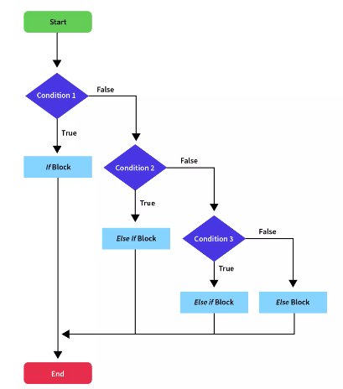
Decision-Making Statements

Slide 3
Examples :
#include <iostream>
using namespace std;
int main() {
int score = 72;
if (score >= 90) {
cout << "Grade A" << endl;
} else if (score >= 75) {
cout << "Grade B" << endl;
} else if (score >= 60) {
cout << "Grade C" << endl;
} else {
cout << "Grade D" << endl;
}
return 0;
}
#include <iostream>
using namespace std;
int main() {
int temperature = 15;
if (temperature > 30) {
cout << "Hot" << endl;
} else if (temperature >= 20) {
cout << "Warm" << endl;
} else if (temperature >= 10) {
cout << "Cool" << endl;
} else {
cout << "Cold" << endl;
}
return 0;
}

Slide 4
Decision-Making Statements
5.Switch Statement
The switch statement is almost similar to the if-else-if ladder in C++.
It is a multi-branch control statement that allows us to choose one block of code to execute out of many options, based on the result of an expression.
Key Points:
The switch works with integers, characters, and enumerated types.
Each block is known as a case.
A default case can be added, similar to the else block in if-else.
break statements are used to stop further case execution (prevent fall-through).
Syntax :
switch (expression) {
case value1:
//code block of case with value1
break;
case value2:
//code block of case with value2
break;
……….
case valueN:
//code block of case with valueN
break;
default:
//code block of default value
}

Slide 5
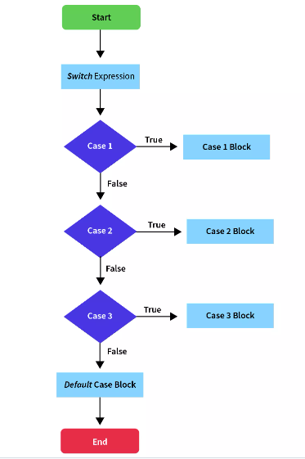
Decision-Making Statements

Slide 6
Examples :
#include <iostream>
using namespace std;
int main() {
int day = 2;
switch (day) {
case 1: cout << "Monday"; break;
case 2: cout << "Tuesday"; break;
case 3: cout << "Wednesday"; break;
default: cout << "Invalid day";
}
return 0;
}
#include <iostream>
using namespace std;
int main() {
char grade = 'B';
switch (grade) {
case 'A': cout << "Excellent"; break;
case 'B': cout << "Good"; break;
case 'C': cout << "Average"; break;
default: cout << "Invalid Grade";
}
return 0;
}

Slide 7
Questions
Write a program to check whether a number is positive.
Write a program to check whether age is 18 or above.
Write a program to check whether a number is even or odd.
Write a program to check whether a number is divisible by 5.
Write a program to check if a number is positive and even.
Write a program to check result: fail (<40), pass (40–74), distinction (75+).
Write a program to display grades based on marks (A, B, C, D).
Write a program to find the largest among three numbers.
Write a program to print weekday name based on week number (1–7).
Write a program to print number of days in a month based on month number.

Slide 8

Thank You
www.opentechz.com

